Slide 1
ENSE496AB: Project

Slide 2
Issue
Currently using Excel spreadsheets to organize data
Can’t access if someone else is using it
Professors going rogue
Not a user friendly experience
Some professors feel like they need to contribute not want to contribute

Slide 3
Solution
We wanted to create a digital habitat where all members (profs, office, etc.) could share and collaborate
We created a web app that converted the current spreadsheet into a more modern web form

Slide 4
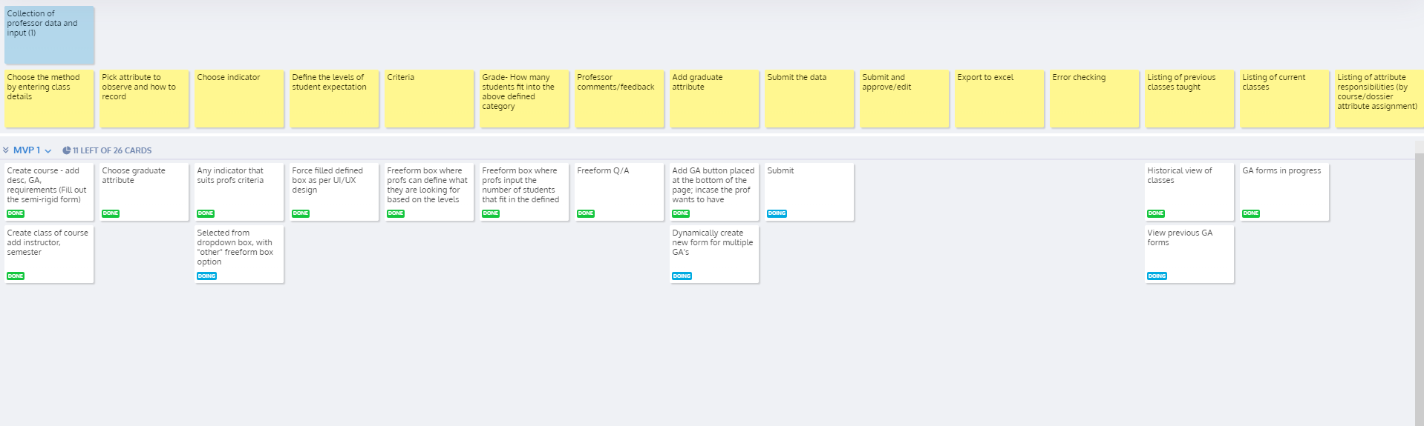
USM

Slide 5
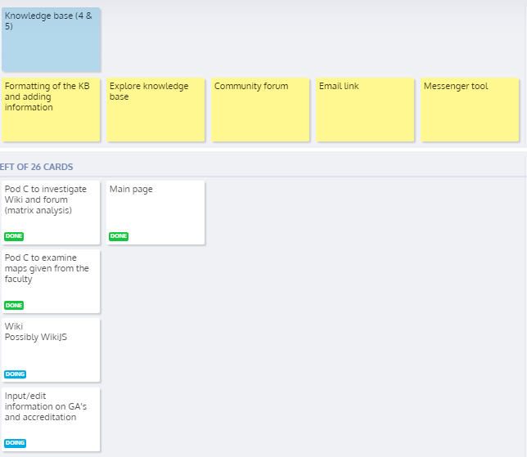
USM

Slide 6
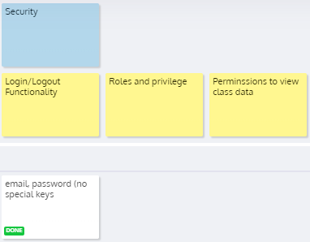
USM

Slide 7
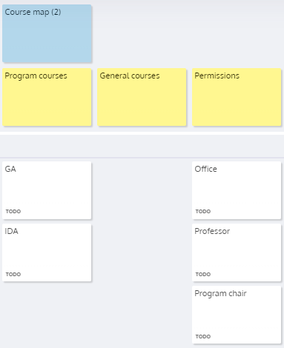
USM

Slide 8
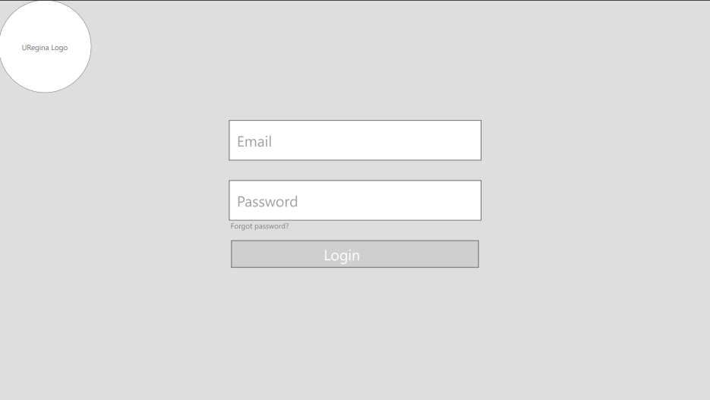
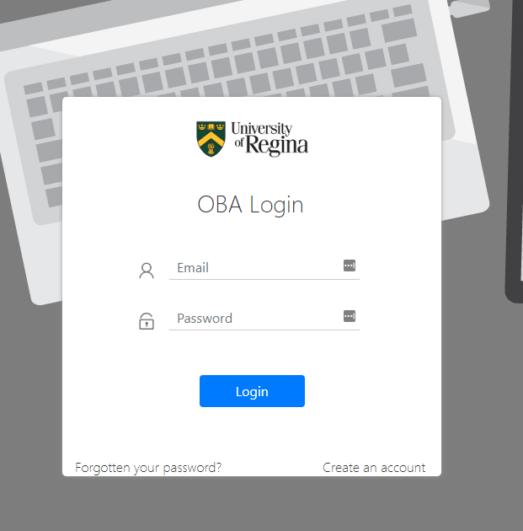
The Process
Input from Dave and Gina
Reworking with new requirements
Input
USM Epics from Dave and Gina
Lofi prototype of UI
Getting Dave and Gina input
Reworking with new requirements
Do it again and again
Include the PDF of lofi prototype

Slide 9
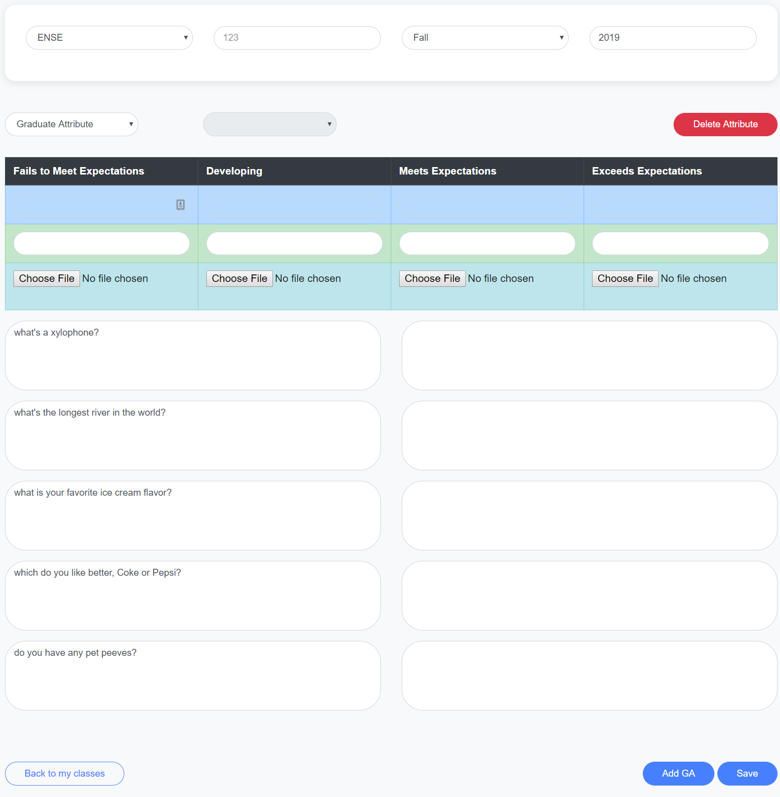
Single source
All Excel sheets into one web based application
Easier to collect data
Form that has clearly defined fields
Button to directly add examples of student work
User are not overwhelmed with how much they have to input at once

Slide 10
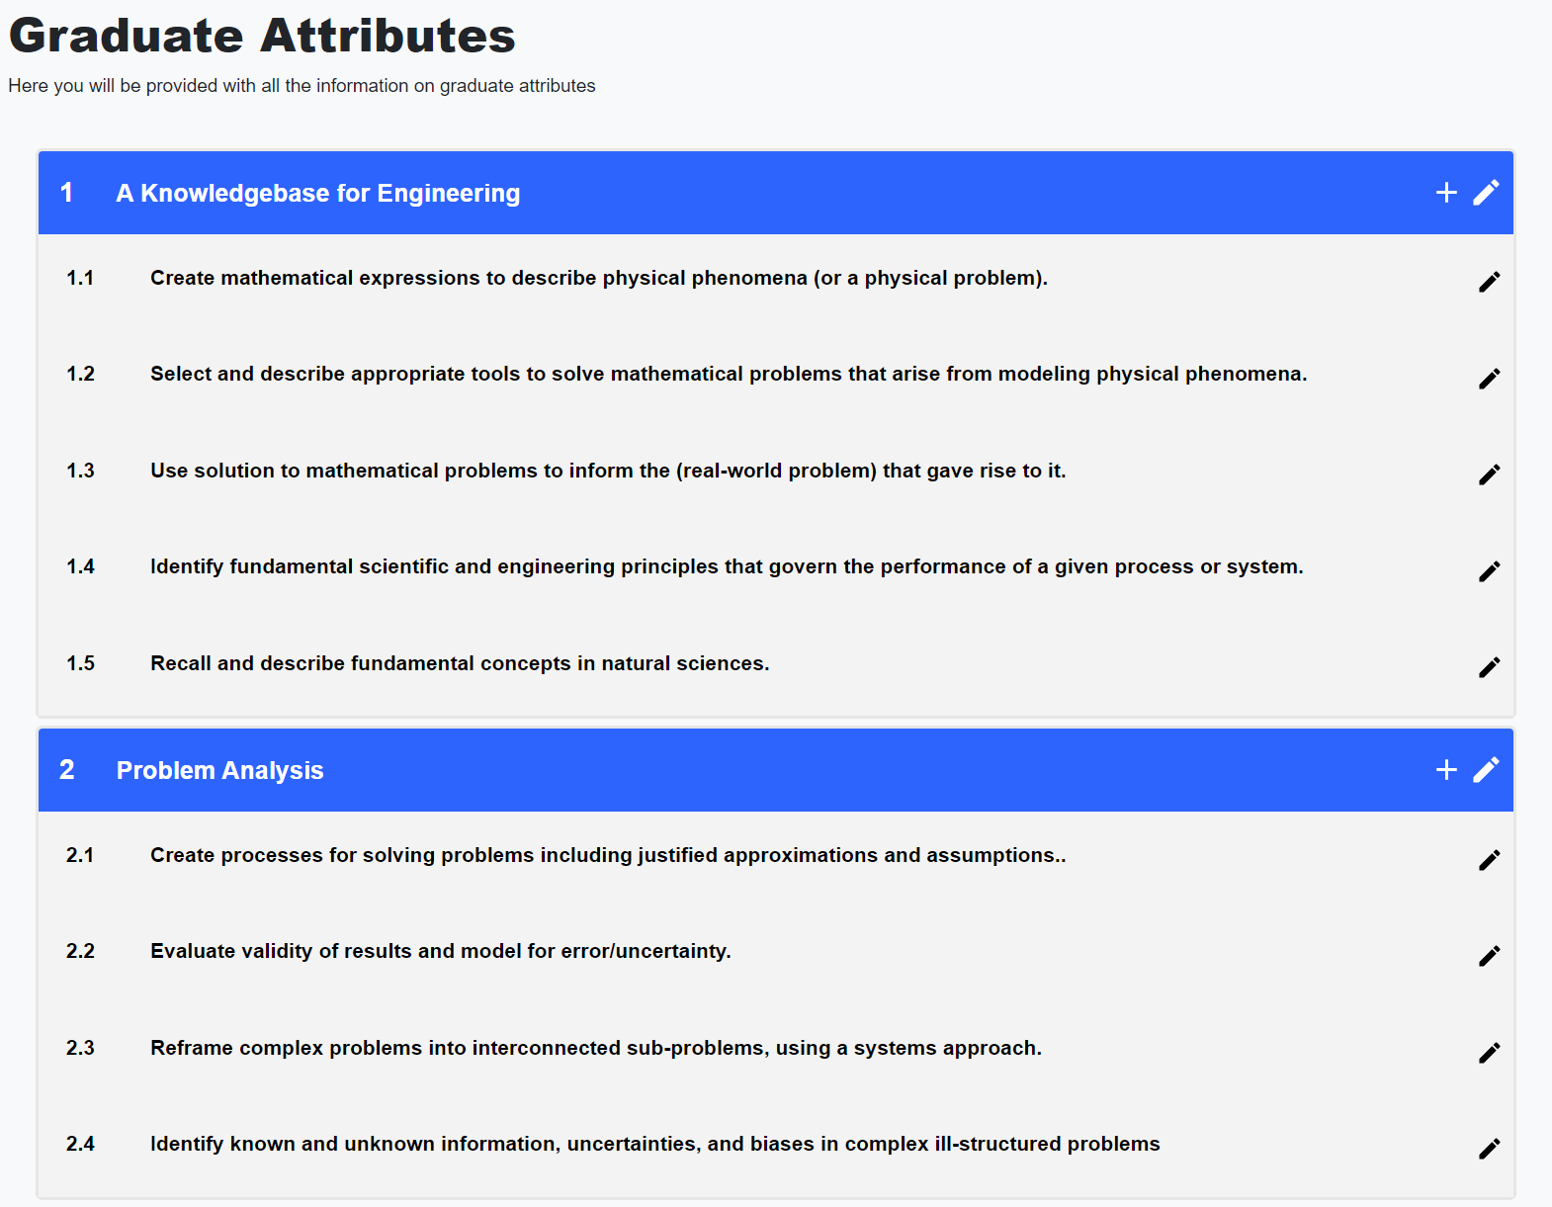
Knowledge Base
Knowledge base stored at a single place, easy to access one source
Can be expanded/edited in the future to include or remove other topics

Slide 11
Communication
There are 3 levels of communication possible within a community: sharing, collaboration, and collective action
Current state of our application is sharing

Slide 12
Communication
In the future we see this app growing to the collaborative or collective action level
Continual learning & continual improvement
Being able to share content and knowledge to other programs, faculties, and potentially schools

Slide 13
Future Tasks
Good start for this project
Lots to do still
Integration with banner/URegina login
Auto generate graphs
Knowledge base tutorials
USM
Gamification

Slide 14
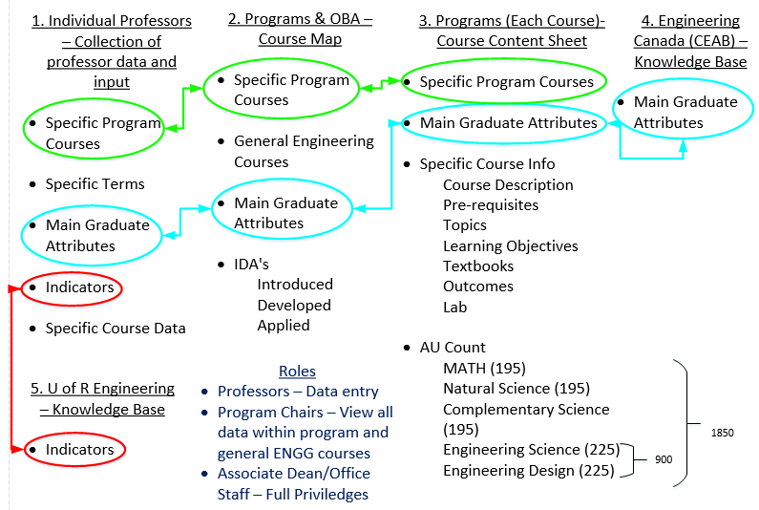

Slide 15
Demos From Pod B and C

